Slide 1
MANUAL TASKS
SERVICES
VFR
CAPTURE
AUTO IMPORT
QC AND OUTPUT
BATCH APPROVAL
EXPORT
AUTO IMPORT
POST VALIDATION
BATCH LOAD BALANCER
FILE CONVERSION
BATCH DELIVERY
INDEXING
SYNCHRONIZER
REPORTING
(any time)
RENAMER
DUPLICATE REMOVER
UPLOADER
BATCH MONITOR

Slide 2
WHAT YOU NEED TO DO …..
1. Define Working Folders
2. Define Work Stations
3. Create Customers
4. Create Projects
5. Create Jobs
6. Configure Auto-Import Services

Slide 3
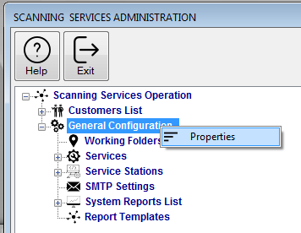
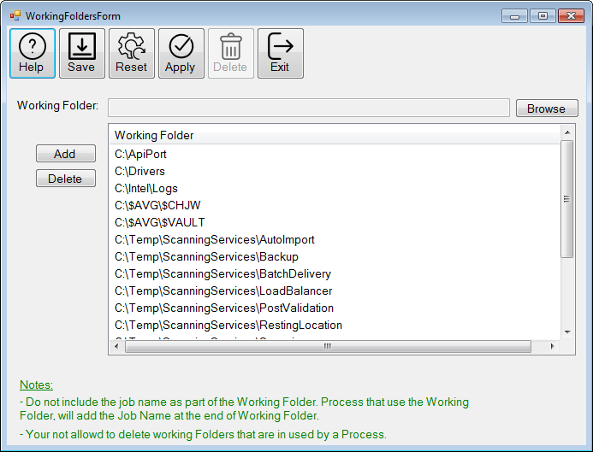
Define Working Folders …..

Slide 4
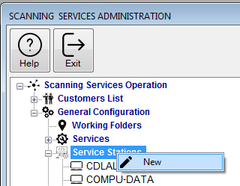
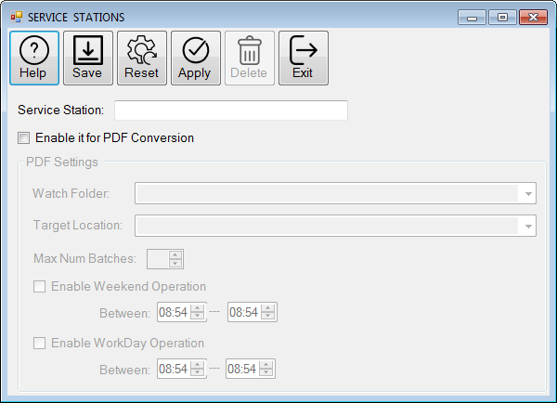
Define Work Stations…..

Slide 5
Create Customers, Projects, and Job Types …..
Customer
Project
Project
Project
Job Type
Job Type
Job Type

Slide 6
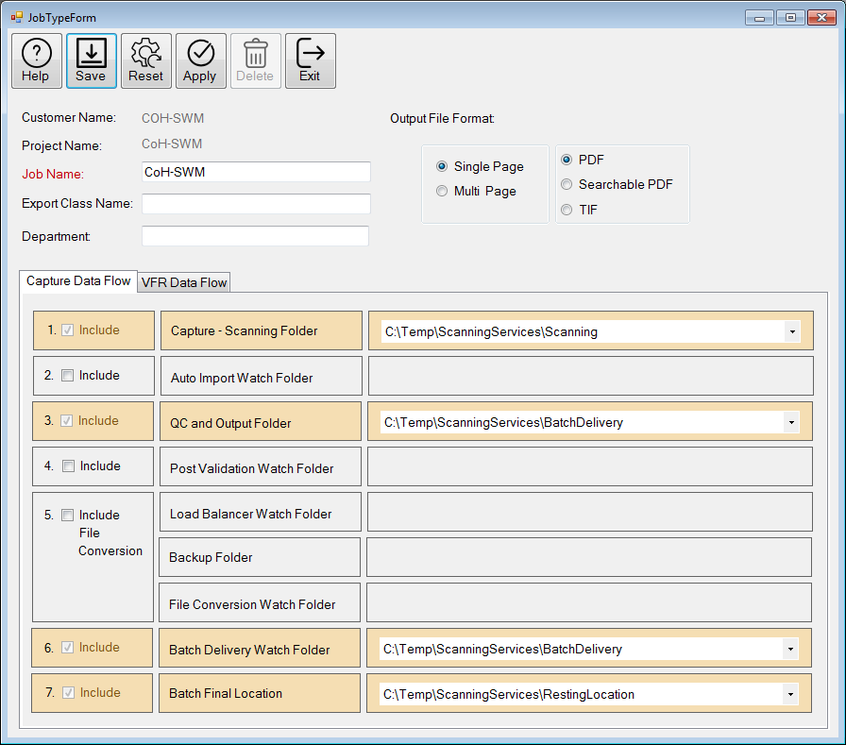
Job Type Configuration …

Slide 7


ALL Jobs
CRON JOB
For ALL Jobs
Job Type
CRON JOB for Specific Job Type
Job Type
z
Job Type
Job Type
Job Type
Server
Job Type
Job Type
CRON JOB for Specific Job Type
Job Type
CRON JOB for Specific Job Type
CRON JOB for Specific Job Type
Server
CRON JOB for Specific Job Type
Server
Auto-Import Service
Configuration …
CRON JOB for Specific Job Type

Slide 8
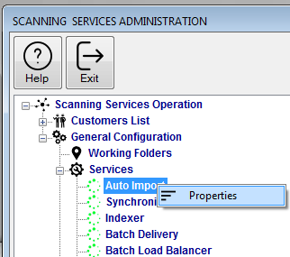
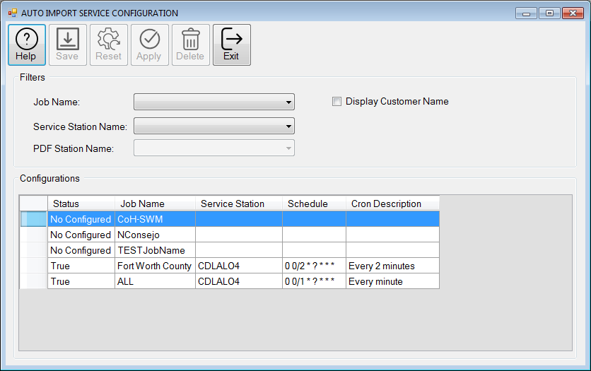
Auto-Import Service Configuration …

Slide 9
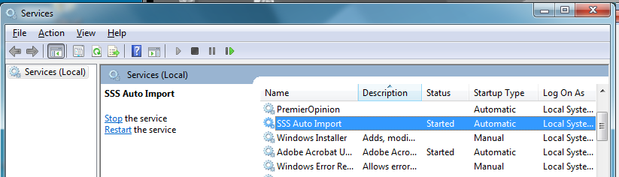
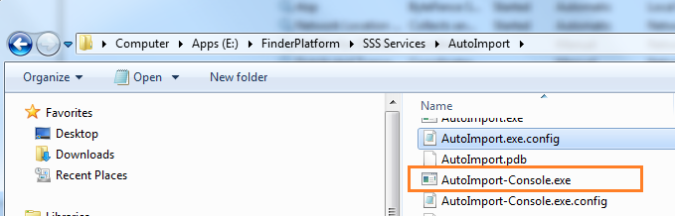
Auto-Import Service
Run Auto Import as a Service
Run Auto Import from a Console

Slide 10
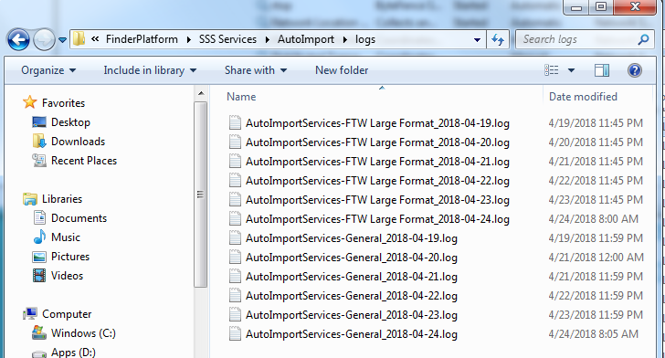
Auto-Import Service Logs …

